Slide 1
Human Reaction and Prediction of Cognitive Performance
module2

Slide 2
human performance:
cognitive
ergonomic

Slide 3
cognitive
Cognitive abilities are brain-based skills we need to carry out any task from the simplest to the most complex.
They have more to do with the mechanisms of how we learn, remember, problem-solve, and pay attention, rather than with any actual knowledge.
For instance, answering the telephone involves perception (hearing the ring tone), decision taking (answering or not), motor skill (lifting the receiver), language skills (talking and understanding language), social skills (interpreting tone of voice and interacting properly with another human being).

Slide 4
Norman and Draper spoke of the “gulf of execution/evaluation,” which explains how users can be left bewildered (and not perform very well) when an interactive system does not offer certain actions or does not result in a state as expected by the user.
The mismatch between the user’s mental model and the task model employed by the interactive system creates the “gulf.” On the other hand, when the task model and interface structure of the interactive system maps well to the expected mental model of the user, the task performance will be very fluid.

Slide 5
two types of memory in the human cognitive system: the short term and the long term.
The short-term memory is also sometimes known as the working memory, in the sense that it contains (changing) memory elements meaningful for the task at hand (or chunks).
Humans are known to remember about eight chunks of memory lasting only a very short amount of time This means that an interface cannot rely on the human’s short-term memory beyond this capacity for fast operation

Slide 6
Retrieving information from the long-term memory is a difficult and relatively time-consuming task.
Therefore, if an interactive system (e.g., targeted even for experts) requires expert-level knowledge, it needs to be displayed so as to at least elicit “recognition” (among a number of options) of it rather than completely relying on recall from scratch.

Slide 7
Predictive Performance Assessment
GOMS Many important cognitive activities have been analyzed in terms of their typical approximate process time, e.g., for single-chunk retrieval from the short-term memory, encoding (memorizing) of information into the long-term memory, responding to a visual stimulus and interpreting its content, etc
GOMS (Goals, Operators, Methods, and Selection

Slide 8
Predictive models
Provide a way of evaluating products or designs without directly involving users.
Less expensive than user testing.
Usefulness limited to systems with predictable tasks - e.g., telephone answering systems, mobiles, cell phones, etc.
Based on expert error-free behavior.
www.id-book.com

Slide 9
GOMS
Goals – what the user wants to achieve eg. find a website.
Operators - the cognitive processes & physical actions needed to attain goals, eg. decide which search engine to use.
Methods - the procedures to accomplish the goals, eg. drag mouse over field, type in keywords, press the go button.
Selection rules - decide which method to select when there is more than one.
www.id-book.com

Slide 10
Keystroke level model
GOMS has also been developed to provide a quantitative model - the keystroke level model.
The keystroke model allows predictions to be made about how long it takes an expert user to perform a task.
www.id-book.com

Slide 11
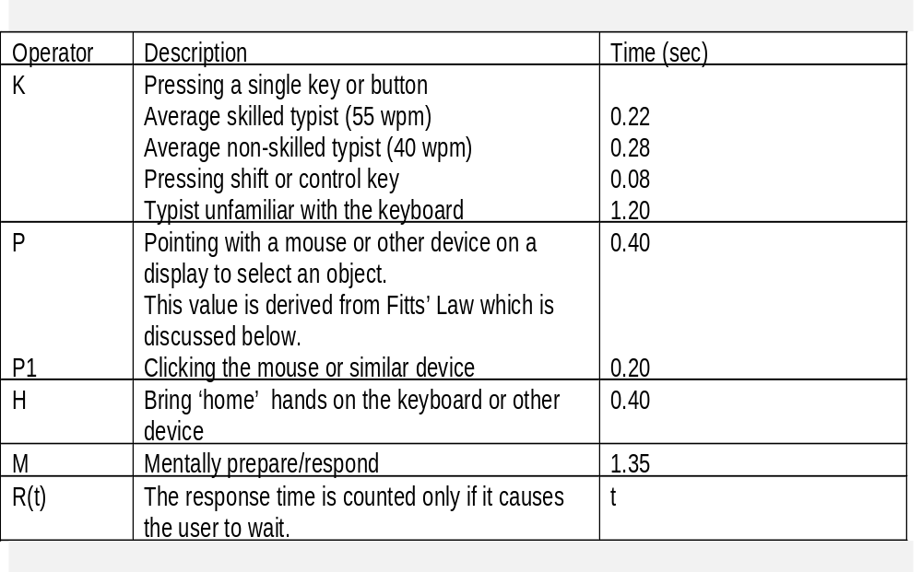
Response times for keystroke level operators (Card et al., 1983)
www.id-book.com

Slide 12
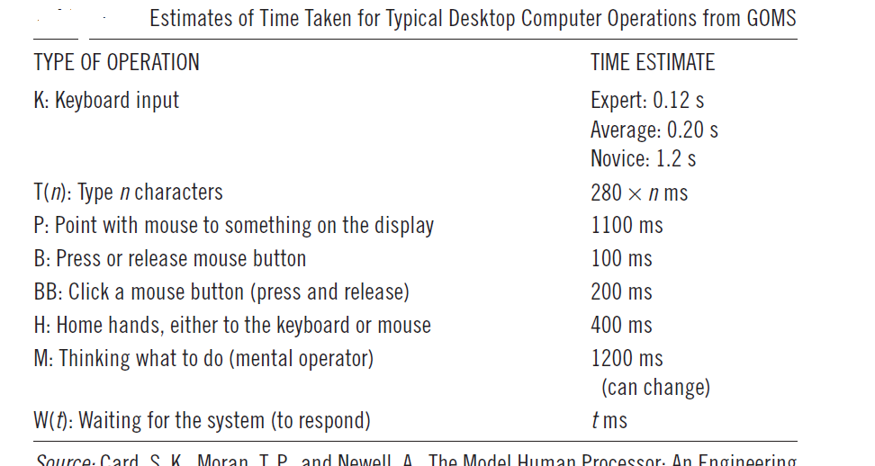

Slide 13

GOMS Models
GOMS Models: A Family of Engineering Models
GOMS Model Family as Simplified Cognitive Architectures

Slide 14

GOMS Models: A Family of Engineering Models
Definition of GOMS model:
An approach to describing the knowledge of procedures that a user must have in
order to operate a system.
• Proposed by Card, Moran, & Newell (1983).
Goals - what goals can be accomplished with the system.
Operators - what basic actions can be performed.
Methods - what sequences of operators can be used to accomplish each goal.
Selection Rules - which method should be used to accomplish a goal.
GOMS is limited to describing procedural knowledge.
Interfaces have other aspects!
Family summarized here:
Keystroke-Level Model (KLM).
Critical-Path Method GOMS (CPM-GOMS).
Natural GOMS Language (NGOMSL)/Cognitive Complexity Theory.
Executable GOMS Language (GOMSL)/GLEAN.

Slide 15

GOMS Model Family as Simplified Cognitive Architectures
Simple Stage Model Architecture.
A sequence of stages, with characteristic times, produces behavior.
Keystroke-Level Model.
Elementary Human Performance Architecture.
Cognitive system executes a procedural knowledge representation.
A shared working memory for temporary task information.
Simple stage model for rest of activity.
Original CMN-GOMS, CCT, NGOMSL models.
Multiple Parallel Processor Architecture.
Perceptual, cognitive, motor processes run in parallel.
• E.g. Card, Moran, & Newell (1983) Model Human Processor.
CPM-GOMS model.
GOMSL/GLEAN.
GOMS Architectures
5

Slide 16

The Keystroke-Level GOMS Model
The Keystroke-Level Model (KLM) Method
Operators and Times for the Keystroke-Level Model
Example: File Deletion in MacOS, Original Design, Experienced User
Example: Command Key File Deletion, Experienced User
Summary: The Keystroke-Level Model
GOMS Architectures
6

Slide 17

The Keystroke-Level Model (KLM) Method
Adapted from Card, Moran, & Newell (1983)
1. Choose one or more representative task scenarios.
2. Have design specified to the point that keystroke-level actions can be listed.
3. List the keystroke-level actions (operators) involved in doing the task.
4. Insert mental operators for when user has to stop and think.
5. Look up the standard execution time to each operator.
6. Add up the execution times for the operators.
7. The total is the estimated time to complete the task.
GOMS Architectures
7

Slide 18

Operators and Times for the Keystroke-Level Model
K - Keystroke (.12 - 1.2 sec; use .28 sec for ordinary user).
Pressing a key or button on the keyboard.
Different experience levels have different times.
Pressing SHIFT or CONTROL key is a separate keystroke.
Use type operator T(n) for a series of n Ks done as a unit.
P - Point with mouse to a target on the display.
Follows Fitts' law - use if possible.
Typically ranges from .8 to 1.5 sec, average (text editing) is 1.1 sec.
B - Press/release mouse button (.1 sec; click is .2).
Highly practiced, simple reaction.
H - Home hands to keyboard or mouse (.4 sec).
W - Wait for system response.
Only when user is idle because can not continue
Have to estimate from system behavior
Often essentially zero in modern systems
M - Mental act of thinking.
Represents pauses for routine activity (not problem-solving).
New users must often pause to remember or verify every step.
Experienced users pause and think only when logically necessary.
Estimates ranges from .6 to 1.35 sec; 1.2 sec is good single value.
GOMS Architectures
8

Slide 19

Example: File Deletion in MacOS, Original Design,
Experienced User
Assumptions:
Experienced user thinks of selecting and dragging an icon as a single operation.
Finding the to-be-deleted icon is still required, since it is different every time.
Moving icons to the trash can is highly practiced:
• The trash can does not have to be located, so finding the trash can is overlapped
with pointing to it.
• Finding the trash can is overlapped with pointing to it.
• Verifying that the trash can has been hit is overlapped with pointing to it.
• Final result (bulging can) is not checked since it is redundant with verifying that
the can has been hit.
Pointing to the original window is overlapped with finding it.
General procedure
Find the file icon to be deleted and drag it to the trash can.
Operator sequence
1. initiate the deletion M
2. find the file icon M
3. point to file icon P
4. press and hold mouse button B
5. drag file icon to trash can icon P
6. release mouse button B
7. point to original window P
Total time = 3P + 2B + 2M = 5.9 sec

Slide 20

Example: Command Key File Deletion, Experienced User
Assumptions:
User operates both mouse and command key with right hand.
Right hand starts and ends on the mouse.
General procedure
Select the file icon to be deleted and hit a command key.
Operator sequence
1. initiate the deletion M
2. find the icon for the to-be-deleted file M
3. point to file icon P
4. click mouse button BB
5. move hand to keyboard H
6. hit command key KK
7. move hand back to mouse H
Total time = P + 2B + 2H + 2K + 2M = 5.06 sec
Only slightly faster, due to need to move the hand!

